Slide 1



LIBRARY MANAGEMENT SYSTEM
Presented by: Hitexa Ingle

Slide 2




PRESENTATION CONTENT
INTRODUCTION
DISADVANTAGE
FLOWCHART
FUTURE SCOPE
ADVANTAGE
CONCULSION

Slide 3


INTRODUCTION
Modern Generation is going to dependable on computer and through computer we use Software. Hence, we are creating an Application for managing library system by using java JDBC.
By using this, we can store a student's information, issue a book and store a student's information who take a book from this library. Mainly this application are used by Library administration.

Slide 4
FLOWCHART

Slide 5



ADVANTAGE
DISADVANTAGE
Staff need to be trained.
The system is expensive and takes a lot of time to set up and maintain.
.
If the system crashes you may not be able to access the data.
There may be redundancies.
Online facility is not available.
Students do not have to wait long queues.
Librarian does not need to worry about books.
This system reduces paper work.
It is easy to handle student's and book records.
This system saves the times.
Information of the students stores permanently.
We can easily retrieve data of book or student by searching their id.

Slide 6

FUTURE SCOPE
If required, the system can be expanded for customer login.
In any system there is always chance for its enhancement and extension
This system can also be enhanced with the change facilities. In future more facilities can be added to the system for its growth.
We can make this system as an application which is very useful to the user and the library authority.

Slide 7

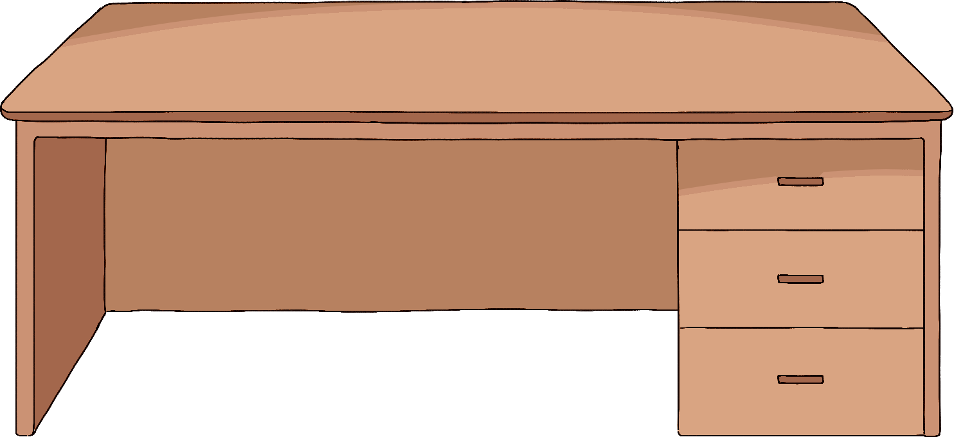
CONCLUSION
In this application we can entry a new book which has a specific id, price, pages, book name, publisher. We also add a student's information such as name, id, father's name, batch, semester which is help admin when a student issue a book & return a book.
If admin wants to see the details information of returning or issuing a book with date, he needs to click just a button on our system.

Slide 8




THANK YOU !

